Slide 1

Leadership & Management L3 Module 1: Design Your Life
Notes:
<number>

Slide 2
1. SHS aims & objectives
2. LM course overview
3. LM module 1: Design Your Life
<number>

Slide 3



Enquête Cadremploi 2019*
ÊTES-VOUS PRÊTS POUR LA RÉVOLUTION SOFT SKILLS ?
84%
DES CADRES SONT À L’AISE AVEC LA NOTION DE SOFT SKILLS
62%
DES CADRES SONT PRÊTS À RECRUTER PRINCIPALEMENT SUR LES SOFT SKILLS
<number>
* https://www.cadremploi.fr/editorial/actualites/actu-emploi/detail/article/etes-vous-prets-pour-la-revolution-soft-skills.html

Slide 4
Enquête Cadremploi 2019*
ÊTES-VOUS PRÊTS POUR LA RÉVOLUTION SOFT SKILLS ?
84%
DES CADRES SONT À L’AISE AVEC LA NOTION DE SOFT SKILLS
43% des 1A N7
62%
DES CADRES SONT PRÊTS À RECRUTER PRINCIPALEMENT SUR LES SOFT SKILLS
31% des 1A N7
(prêts à être recrutés)
<number>
* https://www.cadremploi.fr/editorial/actualites/actu-emploi/detail/article/etes-vous-prets-pour-la-revolution-soft-skills.html

Slide 5

Enquête Cadremploi 2019*
ÊTES-VOUS PRÊTS POUR LA RÉVOLUTION SOFT SKILLS ?
84%
DES CADRES SONT À L’AISE AVEC LA NOTION DE SOFT SKILLS
43% des 1A N7
62%
DES CADRES SONT PRÊTS À RECRUTER PRINCIPALEMENT SUR LES SOFT SKILLS
31% des 1A N7
(prêts à être recrutés)
<number>
* https://www.cadremploi.fr/editorial/actualites/actu-emploi/detail/article/etes-vous-prets-pour-la-revolution-soft-skills.html

Slide 6

ÊTES-VOUS PRÊTS POUR LA RÉVOLUTION SOFT SKILLS ?
9/9/2019
<number>

Slide 7

ÊTES-VOUS PRÊTS POUR LA RÉVOLUTION SOFT SKILLS ?
Prépa CPES
Réunion Pré-rentrée,
9/9/2019
<number>

Slide 8

ÊTES-VOUS PRÊTS POUR LA RÉVOLUTION SOFT SKILLS ?
Prépa CPES
Réunion Pré-rentrée,
9/9/2019
You’d love it! New « Soft Skills » course here too!
<number>

Slide 9

WEF 2022 competencies are…
<number>
Notes:
<number>

Slide 10
WEF 2022 competencies are… soft skills
<number>
Notes:
<number>

Slide 11

Attitudes to language skill acquisition through soft skill modules in English
Attitude conditioned by habits regarding the teaching curriculum
Turning point: moment
of disruption
ACQUISITION
- Soft skills
- Hard skills
3 years of
academic learning
(theoretical knowledge)
= < 10 %
Start
professional life
40 years of
professional experience
(awareness
of self & others)
= > 90 %
LIFELONG LEARNING OVER TIME
Construction of a discourse on soft skills as a need over time
<number>

Slide 12

Attitudes to language skill acquisition through soft skill modules in English
Attitude conditioned by habits regarding the teaching curriculum
Turning point: moment
of disruption
Perception influenced
by personal workplace experiences
ACQUISITION
- Soft skills
- Hard skills
3 years of
academic learning
(theoretical knowledge)
= < 10 %
Start
professional life
40 years of
professional experience
(awareness
of self & others)
= > 90 %
LIFELONG LEARNING OVER TIME
Construction of a discourse on soft skills as a need over time
<number>

Slide 13
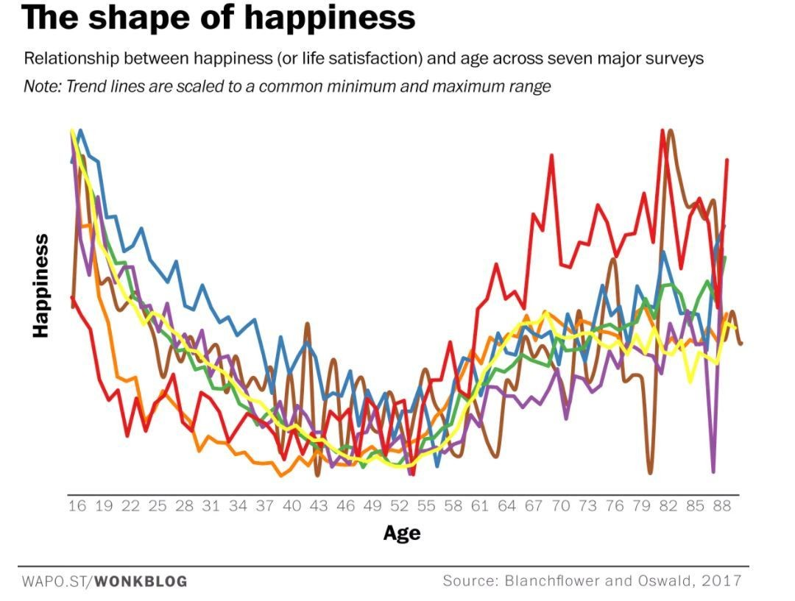
<number>

Slide 14
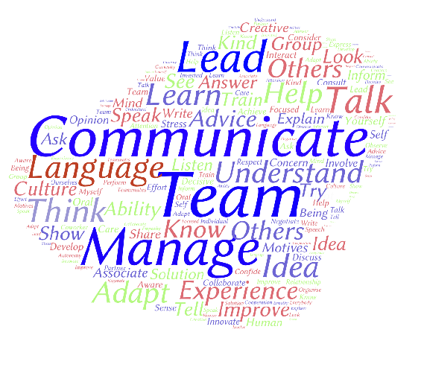

N7 alumni research (2015 to date)
M. Maré, ESPE, M2
N7 alumni survey (2016) : 488 questionnaires, 113 interviews
<number>

Slide 15

4 equally-weighted subjects = 20% of engineering diploma
SHS
Professional English
Sport
Second Language
Leadership & Management
<number>

Slide 16












2017 triptych of 4 equally-weighted subjects = 20% of engineering diploma, 1 day / week
SHS
Professional English
Sport
Second Language
Leadership & Management
8.00 – 9.45
10.15 – 12.00
16.15 – 18.00
The Toulouse INP-N7 multilingual soft skills framework
<number>

Slide 17
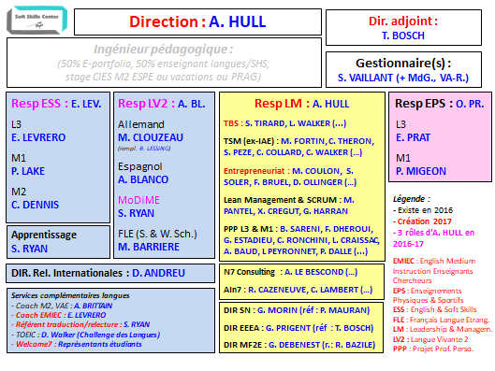
+ 100 trainers : academia, industry, alumni
<number>

Slide 18
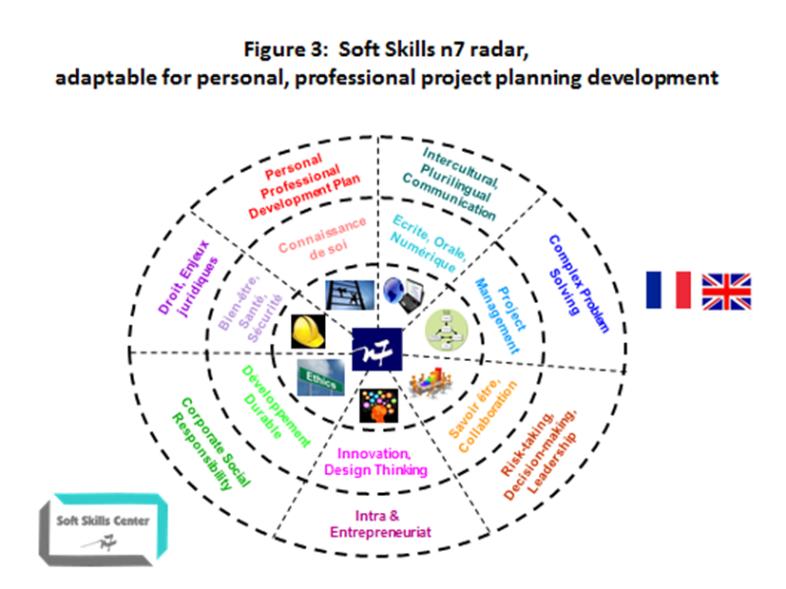
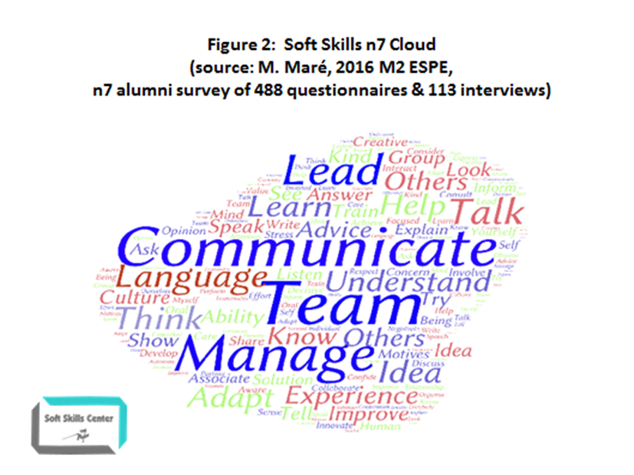
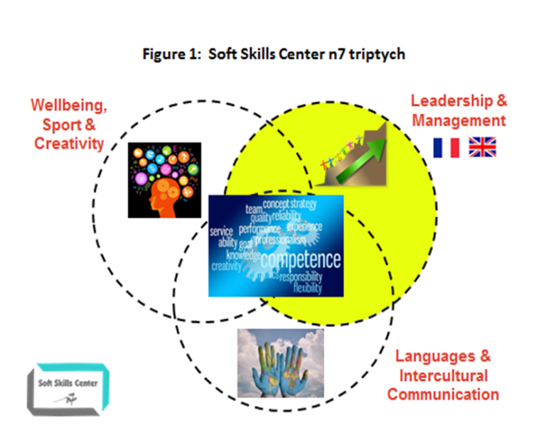








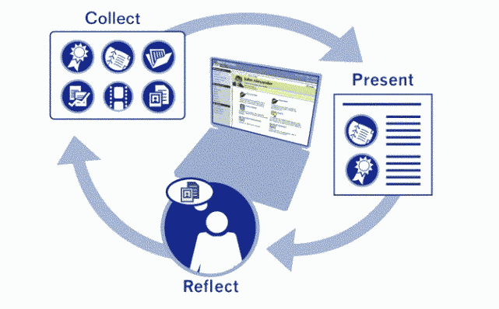

Research-driven
2015 2016 2017 to date

Slide 19




Soft Skills research
Collins, M. (2018). The Engineer of the Future, White Paper 2018 by Airbus Global University Partner Programme (AGUPP), Airbus Employment Marketing for the Airbus Global University Partner Programme
Spar, B., Dye, C., Lefkowitz, R., Pate, D. (2018). 2018 Workplace Learning Report: The Rise and Responsibility of Talent Development in the New Labor Market, Linkedin Learning
http://www.oecd.org/skills/
https://www.weforum.org/reports/the-future-of-jobs-report-2018
(see « human skills » p. 12)

Slide 20

French research
« There is a great emphasis placed nowadays on so-called “soft skills” such as communication, teamwork, empathy, self-motivation and leadership. Some would go so far as to argue that they are just as important, if not more so, than cognitive skills. »
Martin, J. P. (2018). Skills for the 21st Century: Findings and Policy Lessons from the OECD Survey of Adult Skills. OECD Directorate for Education and Skills.

Slide 21
New French CTI guidelines
« The training project leading to the degree meets identified professional needs, in terms of scientific, technical, soft skills, industrial and organisational competencies. The target job market is national and international. »
Accreditation Criteria, Guidelines and Procedures (CTI, 2017: 37)
<number>

Slide 22


WOVEN*, WICS**, VUCA*** communication tasks
(*Georgia Tech, **European Council, ***Harvard)
Sem | Professional English | Comm. Skill | Leadership & Man. | Comm. Skill
5 | Meetings (emails, chair, minutes) TOEIC 1 | W-S-C-I C | HR telephone interview Civics team proposal | C-S-I C-W
6 | CV & letter, Civics SWOT report, TOEIC 2 | W, W C | Civics infogr. poster session ePortfolio & video | W-I-S W-S
7 | Scientific presentation REC interviews, TOEIC 3 | W-S-I W-I, C | Management roleplay PPP formal presentation | C-S-I W-S-I
8 | CSR debates, Reaction paper, TOEIC 4 | S-I C-W, C | Professional ethics roleplay Finance analysis | C-S-I C-W
9 | Projet Long defense docs & tasks (+ B2 Clinic or Camb. tasks), TOEIC 5 | W W-S-I, C | Industrial Property Law (TBC) Complex Business Decisions (TBC) | 2019-2020
Over 20 multimodal professional communication tasks
in French &/or in English
W : Writing I : Interacting C : Comprehending (Listening &/or Reading) S : Speaking
<number>

Slide 23
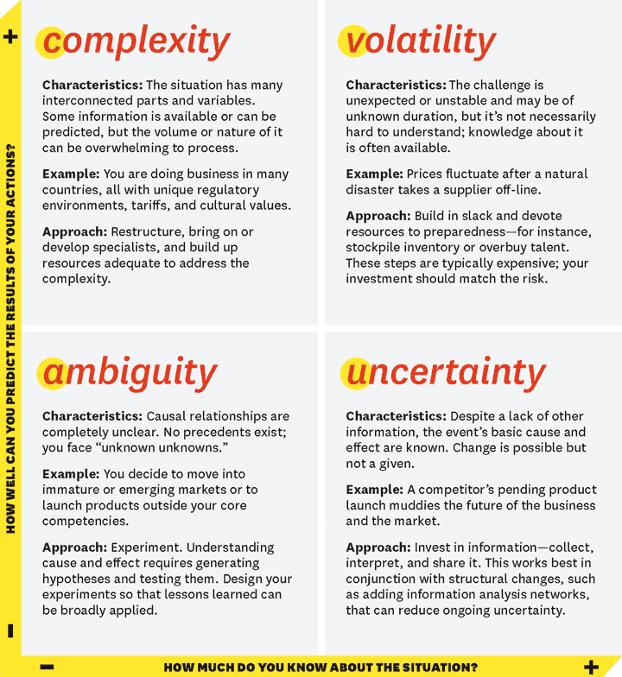
VUCA***
***Harvard
<number>
Source: https://hbr.org/2014/01/what-vuca-really-means-for-you

Slide 24

WOVEN*, WICS**, VUCA*** communication tasks
(*Georgia Tech, **European Council, ***Harvard)
<number>
Source: https://hbr.org/2014/01/what-vuca-really-means-for-you

Slide 25

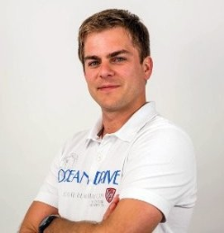
Leadership & Management in « English Medium Instruction (EMI) »
« I only employ people who are… »
David Keribin (SN 2012), N7 Mentor 2018
Co-Founder & President, CityMéo
Team of 20+ employees
HQ in Labège, Toulouse
<number>

Slide 26
Leadership & Management in « English Medium Instruction (EMI) »
« I only employ people who are fluent in English. I’m not interested in TOEIC scores. »
David Keribin (SN 2012), N7 Mentor 2018
Co-Founder & President, CityMéo
Team of 20+ employees
HQ in Labège, Toulouse
<number>

Slide 27

















Leadership & Management L3 & M1
Modules L3 2018-2019 | Partners | Lang. | Competences & Tasks | Hours
1. Design-Think Your Life PPP 1.1 |  |  | Analyse needs & introsp tools, start e-rep. /network, MBTI; HR ph. or skype interview | 10.5 Sept-Nov
2. Teamwork & Project Management |  |  | Discuss basic theories TW/intercult. comp. PM/TW project proposal (one page) | 10.5 Nov-Jan
3. Civic Engagement |  |  | Discuss & develop CE knowledge & skills; Infographic & movie (of work &/or plans) | 10.5 Jan-Mar
4. ePortfolio & video PPP 1.2 |  |  | Design, develop e-Portfolio with « video pitch » to explain option choices | 10.5 Mar-May
Modules M1 2018-2019 | Partners | Lang. | Competences & Tasks | Hours
1. Management & Organization |  |  | Analyse & discuss comp. man & org problems; present case study solution | 10.5 Sept-Nov
2. Pers. Prof. Proj. PPP 2 |  |  | Develop PPP; present PPP V2 to panel of experts; oral defense | 10.5 Nov-Jan
3. Professional Ethics |  |  | Analyse & discuss complex ethical case; group role plays | 10.5 Jan-Mar
4. Finance |  |  | Analyse & discuss financial case studies ; written case study paper | 10.5 Mar-May

Slide 28

PPP : Career Development

Slide 29
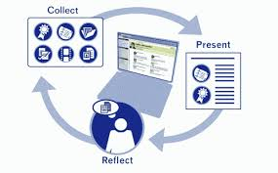
PPP : Career Development

Slide 30
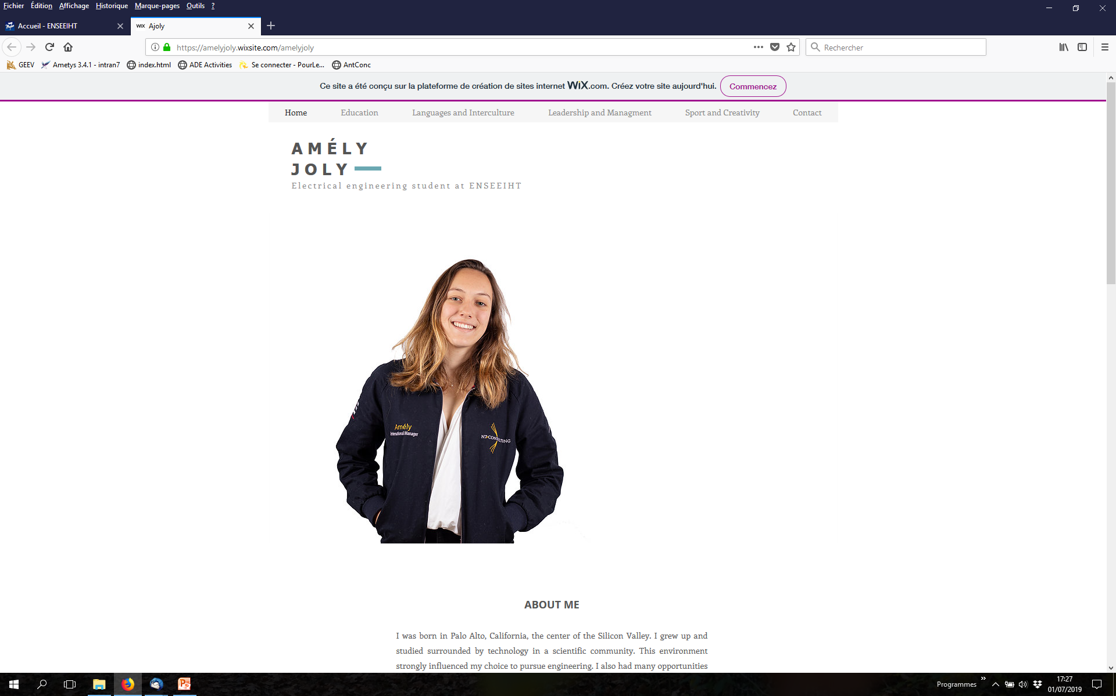

Slide 31
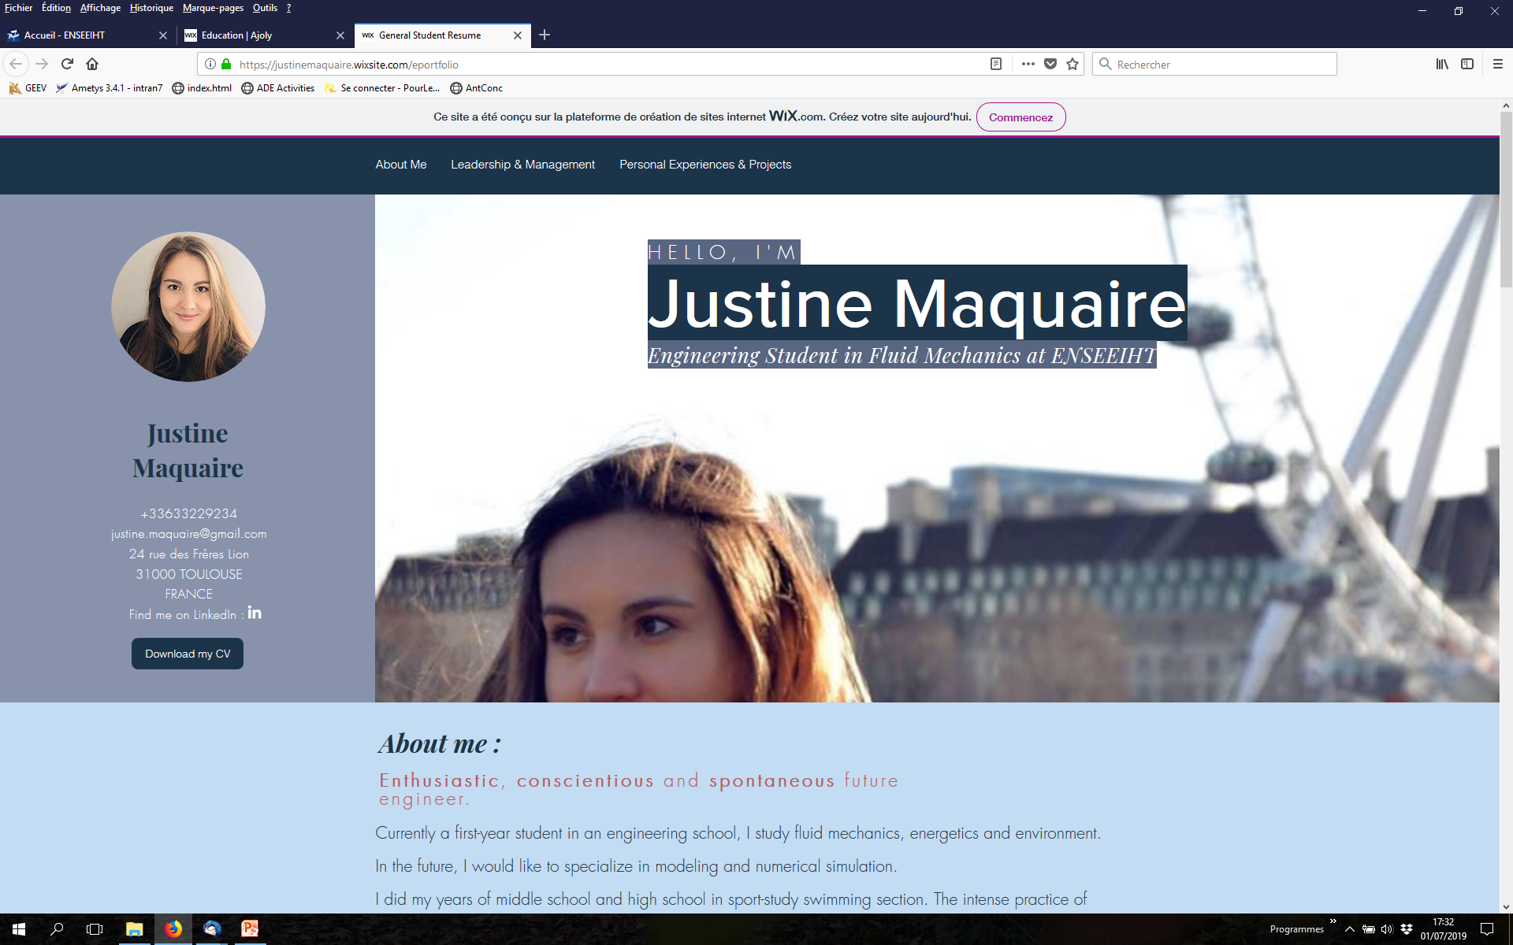

Slide 32
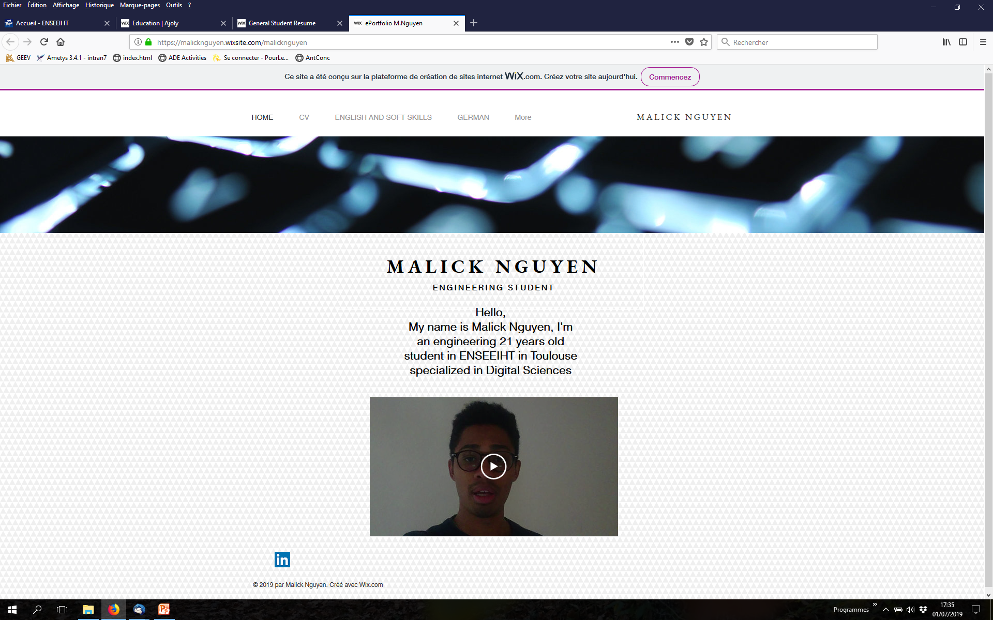

Slide 33
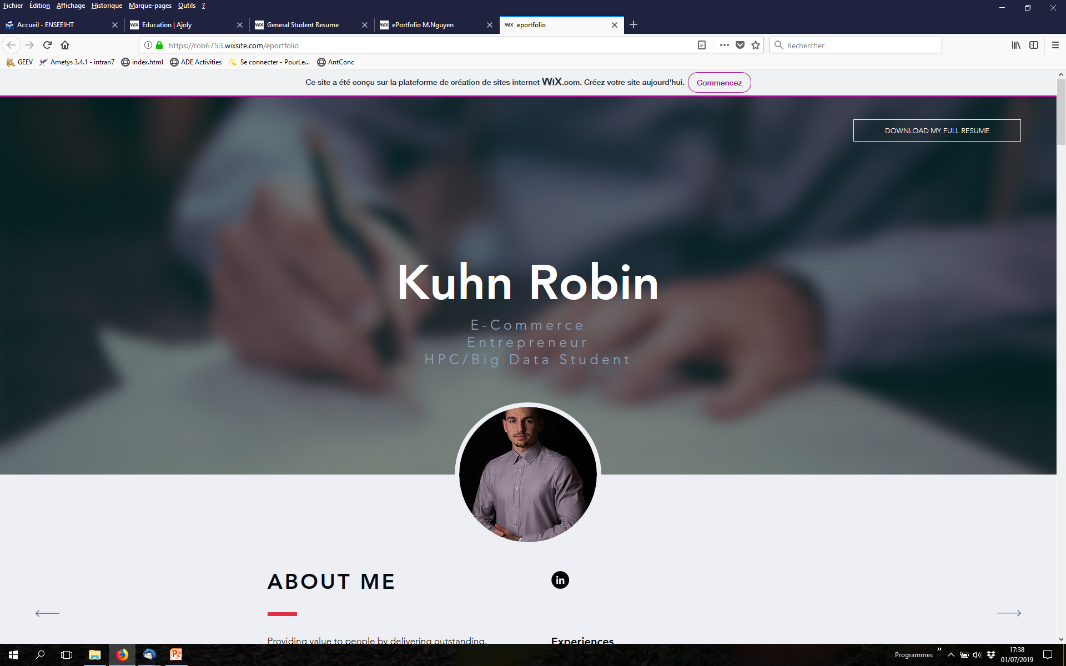

Slide 34



PPP Career Development : Your ePortfolio
Collect & showcase evidence of the progressive mastery of your skills :
Semester 1 : Create your ePortfolio (consult resources on Moodle)

Slide 35

Your ePortfolio
Collect & showcase evidence of the progressive mastery of your skills :
Semester 1 : Create your ePortfolio (consult resources on Moodle)
Semester 2 : Add a 2-minute video to explain your option choices

Slide 36


Your ePortfolio
Collect & showcase evidence of the progressive mastery of your skills :
Semester 1 : Create your ePortfolio (consult resources on Moodle)
Semester 2 : Add a 2-minute video to explain your option choices
April : Upload your ePortfolio to Moodle for consultation by your department heads

Slide 37

Your ePortfolio
Collect & showcase evidence of the progressive mastery of your skills :
Semester 1 : Create your ePortfolio (consult resources on Moodle)
Semester 2 : Add a 2-minute video to explain your option choices
April : Upload your ePortfolio with to Moodle for consultation by your department heads
M1-M2 : Add new evidence as you master new skills

Slide 38

Your ePortfolio
Collect & showcase evidence of the progressive mastery of your skills :
Semester 1 : Create your ePortfolio (consult resources on Moodle)
START work on your ePortfolio TODAY !
NEXT WEEK PPP with THALES ALENIA SPACE !

Slide 39



Innovation-Entrepreneur Option
enrollment semester 6

Slide 40
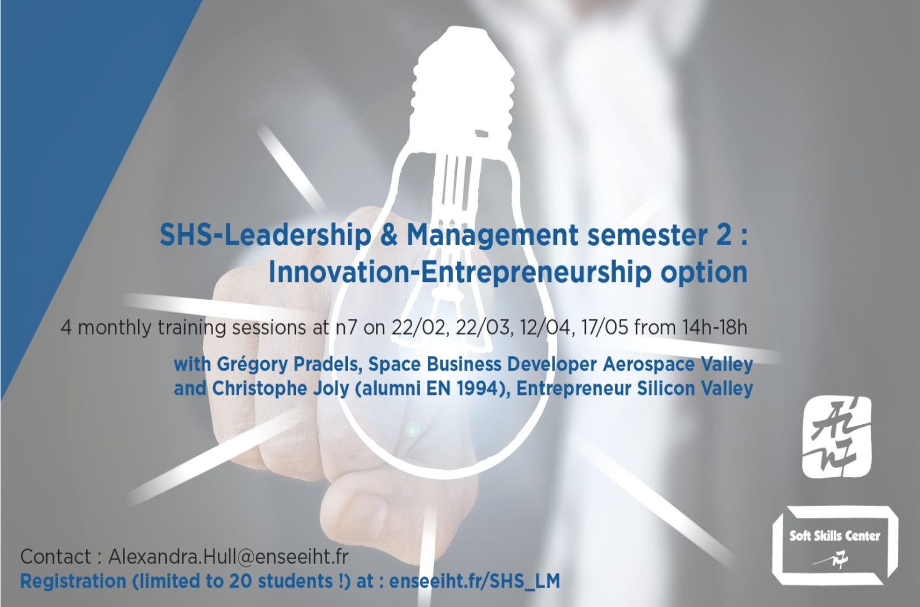
Option Entrepreneuriat from semester 6
Seminars : experts from Aerospace Valley, CNES
Meetups : local ecosystem (French Tech, La Mêlée…)
Workshops : partners (Alcimed, Banque Courtois, Barreau de Tlse, Cabinet Plasseraud…)
Mentor talks : entrepreneur alumni network
Thursday 2-6pm, Tuesday 12.30-1.30pm etc. INSTEAD OF REGULAR LM class !!

Slide 41
SHS-LM Module 1 : Design-Think Your Life
<number>

Slide 42
SHS-LM Module 1 : Design-Think Your Life
Week | Subject | Trainer, university or company | Objective
1 | Intro | A. Hull, N7 R. Cazeneuve, AIN7 | Explore the concept of soft skills, SHS research findings & syllabus
2 | Personal Professional Project (PPP) | Damien Gillette, THALES ALENIA SPACE
3 & 4 | Design-Think Your Life workshops | A. Hull N7
5 | E-reputation & networking | Ludovic Craissac, TSE, TBS, INSA
6 | Evaluation
<number>

Slide 43
SHS-LM Module 1 : Design-Think Your Life
Week | Subject | Trainer, university or company | Objective
1 | Intro | A. Hull, N; R. Cazeneuve, AIN7 | Explore the concept of soft skills, SHS research findings & syllabus
2 | Personal Professional Project (PPP) | Damien Gillette, THALES ALENIA SPACE | Gain an understanding of your PPP & its use throughout your career
3 & 4 | Design-Think Your Life workshops | A. Hull, N7
5 | E-reputation & networking | Ludovic Craissac, TSE, TBS, INSA
6 | Evaluation
<number>

Slide 44
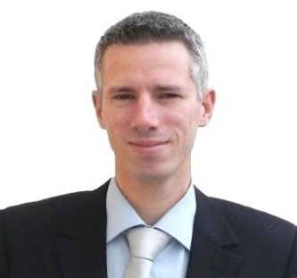
PPP (week 2)
« I’m 39 years old.
The PPP has been a key tool in my career because it… »
Damien Gillette
Project Manager
Thales Alenia Space
Conference at N7 in May 2018
<number>

Slide 45
PPP (week 2)
« I’m 39 years old.
The PPP has been a key tool in my career because it
enables you to set goals, track your progress, reach your goals and
then set new ones. »
Damien Gillette
Project Manager
Thales Alenia Space
Conference at N7 in May 2018
<number>

Slide 46
SHS-LM Module 1 : Design-Think Your Life
Week | Subject | Trainer, university or company | Objective
1 | Intro | A. Hull, N7 R. Cazeneuve, AIN7 | Explore the concept of soft skills, SHS research findings & syllabus
2 | Personal Professional Project (PPP) | Damien Gillette, THALES ALENIA SPACE | Gain an understanding of your PPP & its use throughout your career
3 & 4 | Design-Think Your Life workshops | A. Hull, N7 | Discover key concepts & tools to explore personal profile
5 | E-reputation & networking | Ludovic Craissac, TSE, TBS, INSA
6 | Evaluation
<number>

Slide 47
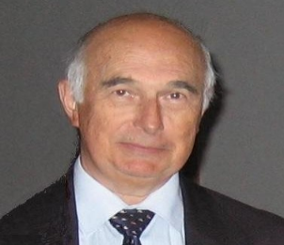
Design-Think Your Life (weeks 3 & 4)
« A big problem with many N7 engineers
I have interviewed for jobs is… »
Richard Cazeneuve (3EA 1972)
Senior Engineer EDF / RTE
Vice-President CR2PA
Vice-President AIN7
<number>

Slide 48
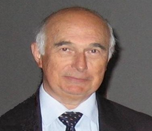
Design-Think Your Life (week 3 & 4)
« A big problem with many N7 engineers
I have interviewed for jobs is
that they don’t know who they are
or what they want or how to
talk about themselves. »
Richard Cazeneuve (3EA 2011)
Senior Engineer EDF / RTE
Vice-President CR2PA
Vice-President AIN7
<number>

Slide 49
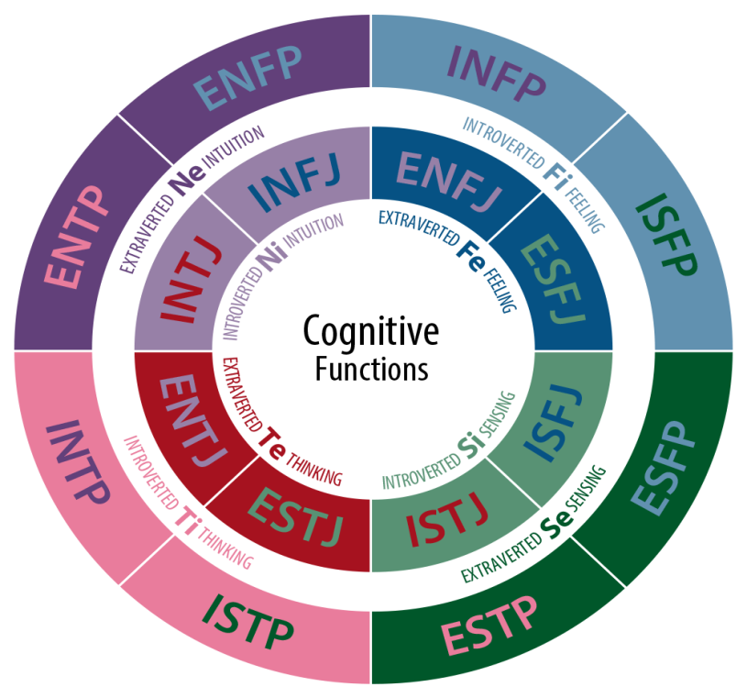

Design-Think Your Life (weeks 3 & 4)
Myers Briggs Type Indicator : 100 years research (Jung)
Widely used, easy-to-use : widely criticised
= ONE tool : there are many others !
<number>

Slide 50
SHS-LM Module 1 : Design-Think Your Life
Week | Subject | Trainer, university or company | Objective
1 | Intro | A. Hull, N7 R. Cazeneuve, AIN7 | Explore the concept of soft skills, SHS research findings & syllabus
2 | Personal Professional Project (PPP) | Damien Gillette, THALES ALENIA SPACE | Gain an understanding of your PPP & its use throughout your career
3 & 4 | Design-Think Your Life workshops | A. Hull, N7 | Discover key concepts & tools to explore personal profile
5 | E-reputation & networking | Ludovic Craissac, TSE, TBS, INSA | Develop your professional & social networking skills
6 | Evaluation
<number>

Slide 51
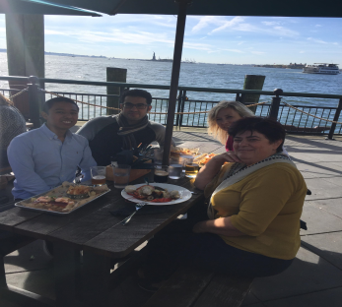
E-reputation & Networking (week 5)
« My advice ? Tell your students to start… »
Moaad El Amrani (SN 2011)
Software Development Engineer
Amazon.com Seattle & New York
with Emilio Borraz Ortega (SN 2011)
Senior Developer
North America Power, New York
AIN7-USA meetup New York, Oct 2017
<number>

Slide 52
E-reputation & Networking (week 5)
« My advice ? Tell your students to start building their networks & attending
meetups whilst at N7.
Everything works via referral. »
Moaad El Amrani (SN 2011)
Software Development Engineer
Amazon.com Seattle & New York
with Emilio Borraz Ortega (SN 2011)
Senior Developer
North America Power, New York
AIN7-USA meetup New York, Oct 2017
<number>

Slide 53
SHS-LM Module 1 : Design-Think Your Life
Week | Subject | Trainer, university or company | Objective
1 | Intro | A. Hull, N7 R. Cazeneuve, AIN7 | Explore the concept of soft skills, SHS research findings & syllabus
2 | Personal Professional Project (PPP) | Damien Gillette, THALES ALENIA SPACE | Gain an understanding of your PPP & its use throughout your career
3 & 4 | Design-Thinking Your Life workshops | A. Hull, N7 | Discover key concepts & tools to explore personal profile
5 | E-reputation & networking | Ludovic Craissac, TSE, TBS, INSA | Develop your professional & social networking skills
6 | Evaluation | SHS trainers (LM & PE) N7, ISAE-SupAéro, TBS, TSM, TSE | Present yourself effectively in…
<number>

Slide 54

SHS-LM Module 1 : Design-Think Your Life
Week | Subject | Trainer, university or company | Objective
1 | Intro | A. Hull, N7 R. Cazeneuve, AIN7 | Explore the concept of soft skills, SHS research findings & syllabus
2 | Personal Professional Project (PPP) | Damien Gillette, THALES ALENIA SPACE | Gain an understanding of your PPP & its use throughout your career
3 & 4 | Design-Think Your Life workshops | A. Hull, N7 | Discover a key concepts & tools to explore personal profile
5 | E-reputation & networking | Ludovic Craissac, TSE, TBS, INSA | Develop your professional & social networking skills
6 | Evaluation | SHS trainers (LM & PE) N7, ISAE-SupAéro, TBS, TSM, TSE | Present yourself effectively in a HR phone interview (10 minutes in English : prep. in PE classes)
<number>

Slide 55

<number>

Slide 56
HR phone interview (November)
Evaluated roleplay
You have just completed a soft skills analysis (of your choice) as part of a recruitment process to assess your self-awareness, capacity for personal reflection & critical thinking.
<number>

Slide 57
HR phone interview (November)
Evaluated roleplay
You have just completed a soft skills analysis (of your choice) as part of a recruitment process to assess your self-awareness, capacity for personal reflection & critical thinking.
Tools you can refer to : MBTI, Personal Effectiveness Quotient (PEQ), Rucher, Ikigai, Enneagram etc.
<number>

Slide 58
HR phone interview (November)
Evaluated roleplay
You have just completed a soft skills analysis (of your choice) as part of a recruitment process to assess your self-awareness, capacity for personal reflection & critical thinking.
Tools you can refer to : MBTI, Personal Effectiveness Quotient (PEQ), Rucher, Ikigai, Enneagram etc.
You phone HR to discuss your profile.
<number>

Slide 59
HR phone interview (November)
Evaluated roleplay
You have just completed a soft skills analysis (of your choice) as part of a recruitment process to assess your self-awareness, capacity for personal reflection & critical thinking.
Tools you can refer to : MBTI, Personal Effectiveness Quotient (PEQ), Rucher, Ikigai, Enneagram etc.
You phone HR to discuss your profile.
The interviewer is looking for …
<number>

Slide 60
HR phone interview (November)
Evaluated roleplay
You have just completed a soft skills analysis (of your choice) as part of a recruitment process to assess your self-awareness, capacity for personal reflection & critical thinking.
Tools you can refer to : MBTI, Personal Effectiveness Quotient (PEQ), Rucher, Ikigai, Enneagram etc.
You phone HR to discuss your profile.
The interviewer is looking for evidence of self-awareness, personal reflection & critical thinking relative to your PPP
<number>

Slide 61

HR interview questions (November)
Hello, HR office: how can I help? Who’s calling? Who would you like to speak to? What are you calling about?
Thanks for calling. Can you tell me briefly about yourself?
<number>

Slide 62
HR interview questions (November)
Hello, HR office: how can I help? Who’s calling? Who would you like to speak to? What are you calling about?
Thanks for calling. Can you tell me briefly about yourself?
Which tools did you use and why?
Do you agree with the results? Why/why not?
What did you learn about yourself? Explain.
Which other tools have you experimented with?
What are your strengths & weaknesses?
How can you improve on your weaknesses?
How will your strengths help you professionally? Why?
Are you a teamplayer or a teamleader? Why?
How do people describe you? What examples do they give?
<number>

Slide 63
Civic Engagement & Outreach

Slide 64
Civic Engagement & Outreach
Règlement de Scolarité N7
Requirements to obtain your diploma :
English level B2+ & TOEIC score of 785 / 990 points
3 month stay abroad

Slide 65
Civic Engagement & Outreach
Règlement de Scolarité N7
Requirements to obtain your diploma :
English level B2+ & TOEIC score of 785 / 990 points
3 month stay abroad
A semester of civic engagement & outreach activity of your choice (new in 2018-2019)

Slide 66
Leadership & Management L3 & M1
Modules L3 | Partners | Lang. | Competences & Tasks | Hours
1. Design-Thinking Your Life PPP 1.1 |  |  | Analyse needs & introsp tools, start e-rep. /network, MBTI; HR ph. or skype interview | 10.5 Sept-Nov
2. Teamwork & Project Management |  |  | Discuss basic theories TW/intercult. comp. PM/TW project proposal (one page) | 10.5 Nov-Jan
3. Civic Engagement |  |  | Discuss & develop CE knowledge & skills; Infographic & movie (of work &/or plans) | 10.5 Jan-Mar
4. ePortfolio & video PPP 1.2 |  |  | Design, develop e-Portfolio with « video pitch » to explain option choices | 10.5 Mar-May
Modules M1 | Partners | Lang. | Competences & Tasks | Hours
1. Management & Organization |  |  | Analyse & discuss comp. man & org problems; present case study solution | 10.5 Sept-Nov
2. Pers. Prof. Proj. PPP 2 |  |  | Develop PPP; present PPP V2 to panel of experts; oral defense | 10.5 Nov-Jan
3. Professional Ethics |  |  | Analyse & discuss complex ethical case; group role plays | 10.5 Jan-Mar
4. Finance |  |  | Analyse & discuss financial case studies ; written case study paper | 10.5 Mar-May

Slide 67

Civic Engagement & Outreach
200 years success research
7 honorary doctorates

Slide 68

Civic Engagement & Outreach
200 years success research
7 honorary doctorates
2006 : 8th habit

Slide 69

Civic Engagement & Outreach : from effective to great
Interdependence is a higher
value than independence
Teamwork, Collaboration
<number>

Slide 70
Civic Engagement & Outreach : from effective to great
Interdependence is a higher
value than independence
Teamwork, Collaboration
Find your voice and inspire
others to find theirs
Autonomy, Communication
<number>

Slide 71
Civic Engagement & Outreach : from effective to great
Interdependence is a higher
value than independence
Teamwork, Collaboration
Find your voice and inspire
others to find theirs
Autonomy, Communication
Give back to society/environment
Integrity, Ethics, Vision
<number>

Slide 72
Civic Engagement & Outreach: suggested activities
In-house associations
Student board representation, Welcome7, Green7eam, Huma7 etc.
<number>

Slide 73
Civic Engagement & Outreach: suggested activities
In-house associations
Student board representation, Welcome7, Green7eam, Huma7 etc.
National associations
Junior Entreprise, Charities etc.
<number>

Slide 74
Civic Engagement & Outreach: suggested activities
In-house associations
Student board representation, Welcome7, Green7eam, Huma7 etc.
National &/or international associations
Junior Entreprise, Charities etc.
Creation of new associations/services
Diversity, Equality etc.
TedXINPENSEEIHT etc.
<number>

Slide 75
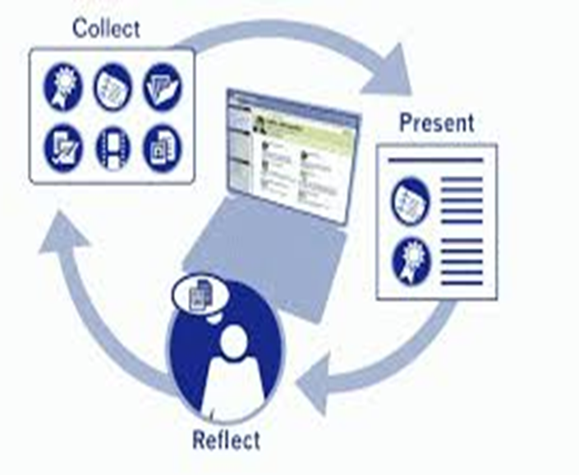
Civic Engagement & Outreach: from effective to great
Make a difference
@N7 & beyond
<number>

Slide 76

Civic Engagement & Outreach: from effective to great
Make a difference
@N7 & beyond
… in a good way
<number>

Slide 77
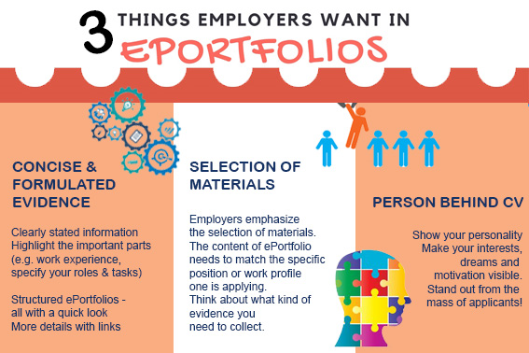
Civic Engagement & Outreach: from effective to great
Source: Journal of Finnish Universities of Applied Sciences
https://uasjournal.fi/in-english/eportfolios-way-to-empower-students/
<number>

Slide 78
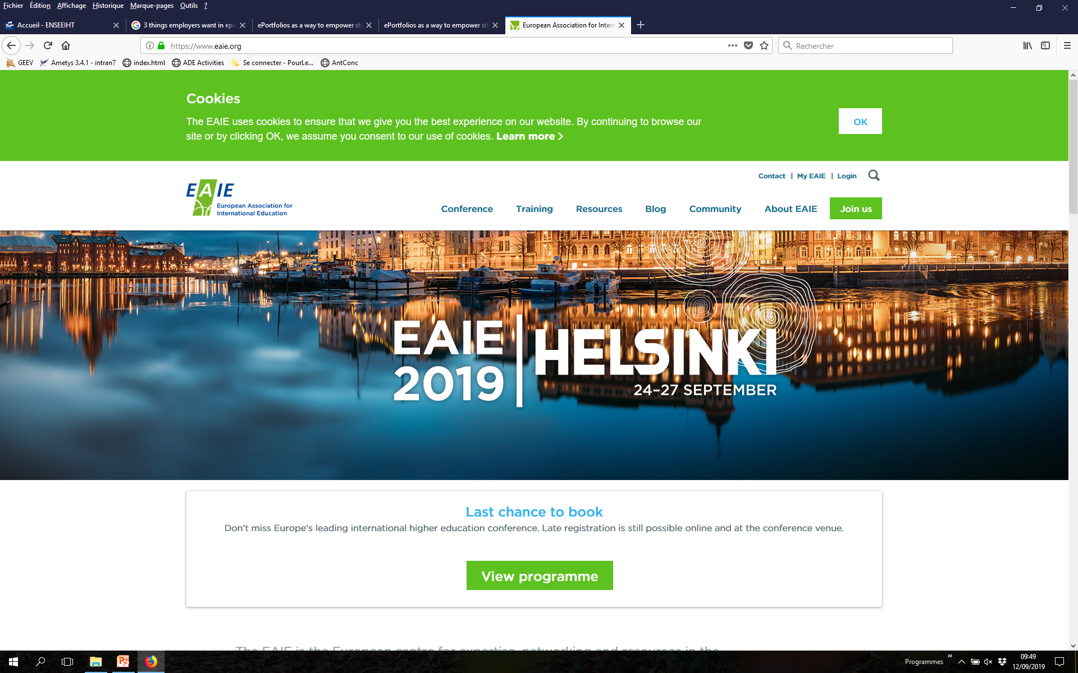
European Association for International Education
Global Conference 2019, Finland
<number>

Slide 79

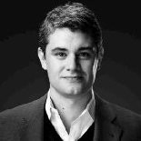
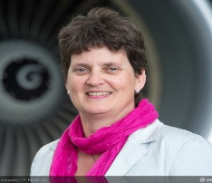
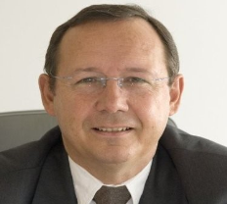
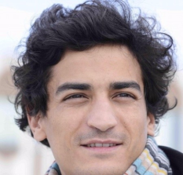
N7 engineers « give back »
« Soft Skills are key to my career » examples on
Sébastien Matringe (MFEE 2004)
Manager at Newfield Exploration, Houston, Texas
Board of Directors, Institute for Applied & Computational Science,
Harvard University
Dominique Bonnet (EEEA 1984)
Head of FAL A350 Leadtime reduction Platform at Airbus
Talks on diversity (TEDxINPENSEEIHT etc.)
Jean-Marc Leroy (EEEA 1979)
Senior Executive Vice President ENGI
President N7 School Council
Antoine Adil Aamarcha (SN 2009)
CEO Gogowego, Entrepreneur
Ambassadeur de la ville de Toulouse; N7 Mentor 2017-2018
<number>

Slide 80

Find out more:
join the N7 networks on
… & be ready for
« E-reputation » (week 5) !
<number>

Slide 81

Initiative & Attitude
Be proactive! Develop your soft skills for next class (session 2):
Autonomy & creativity: Read the ePortfolio resources on Moodle SHS & create a basic Wix (?) ePortfolio
Curiosity: Try out a « career development » personality test https://www.truity.com/view/tests/personality-career
Networking: Join LinkedIn
<number>

Slide 82

PPP (session 2)
Damien Gillette
Project Manager
<number>

Slide 83

PPP (session 2)
Damien Gillette
Project Manager
<number>

Slide 84

PPP (session 2)
Damien Gillette
Project Manager
<number>

